Slide 1
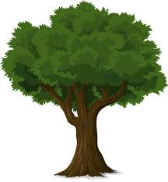
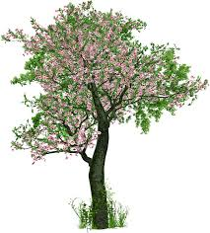
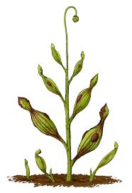
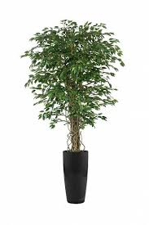
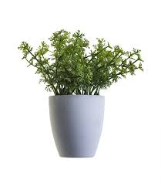
The Plant Fairy

Slide 2
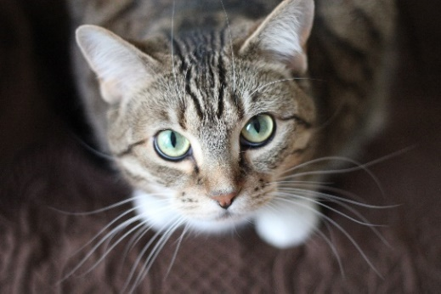
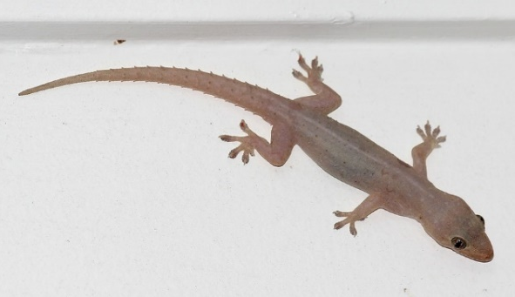
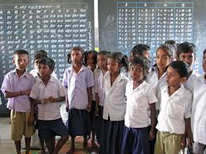
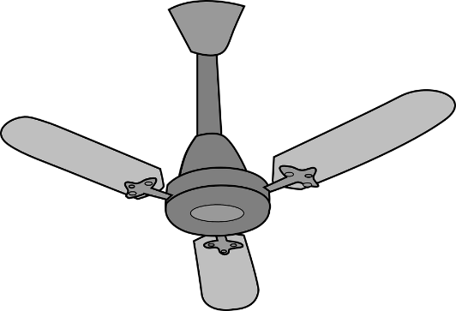
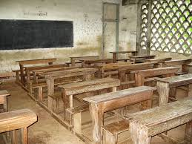
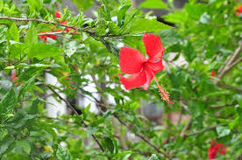
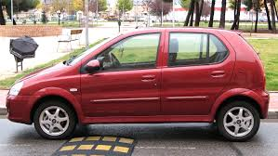
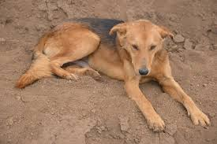
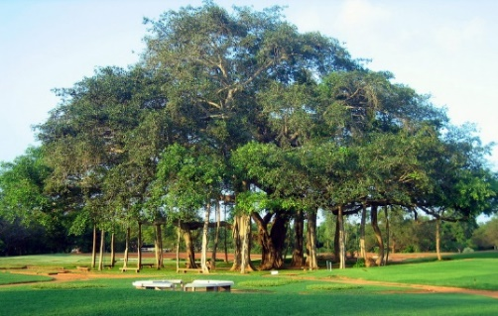
Can you categorize living and non-living from these pictures, why do you think so?
Living and Non-living
Notes:
Let the students guess from this slide- which is living and non-living.
Please don’t give away answers- this is purely to help students think and reason why the think so.

Slide 3
Why do you say they are living or non-living
Notes:
Let the students to think the qualities of a living things- they could come up with a lot of reasons- write down all reasons they say on the black board- also ask them reasons for why they think so.

Slide 4
Is car Living or Non-living
Notes:
Elicit responses from the students

Slide 5
Will you agree if I say a cat is non-living? Why do you think so
Notes:
Elicit responses from students- ask probing questions.

Slide 6
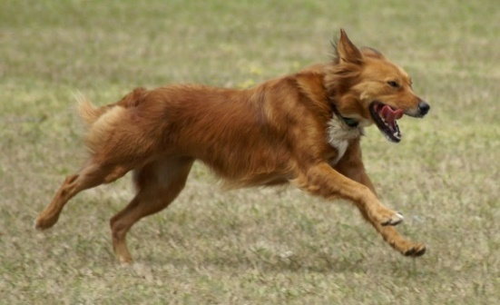
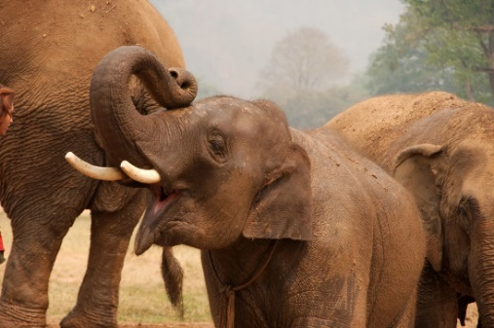
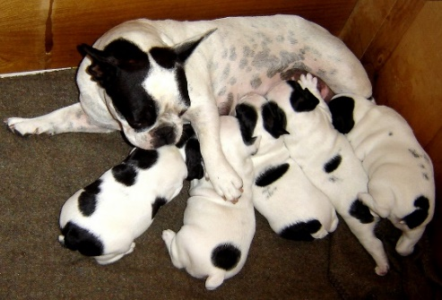
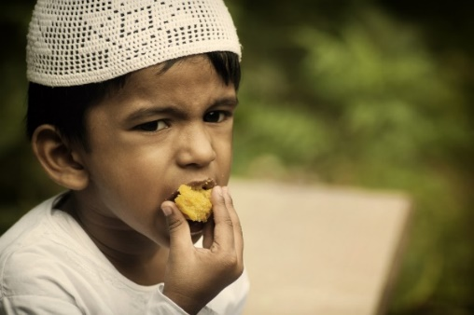
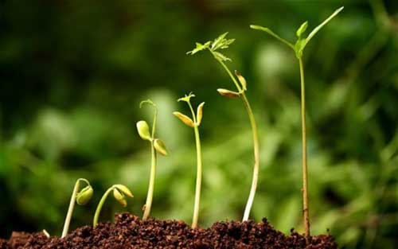
Characteristics of living things:
Move
Breath
Grow
Eat
Make noise
Reproduce
Feel
Die
Notes:
This slide is purely for summarizations, add to the points written if students have shared a different point.
Students to think on qualities: give them contrasting examples Dog Vs Car, Coconut tree Vs a plane etc

Slide 7
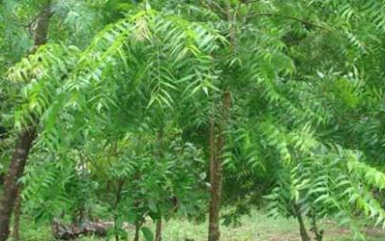
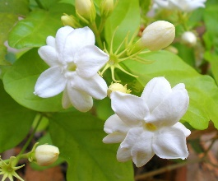
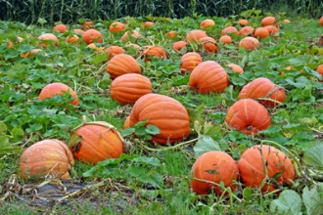
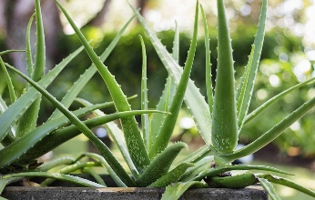
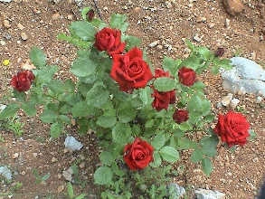
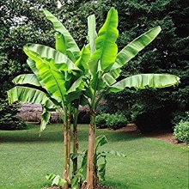
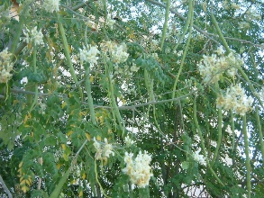
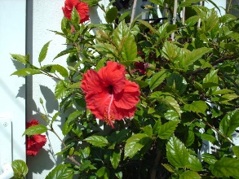
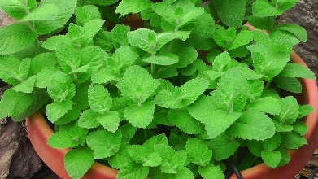
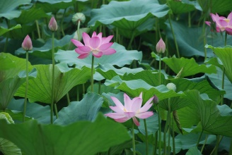
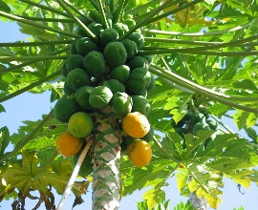
Can you name some of these?
What are different types of plants you know
Notes:
Ask students to identify these plants- add to the list other plants they say.

Slide 8
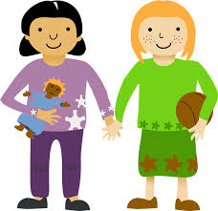
Can you name different parts of these children
Notes:
Ask students to name body parts- sharing in Tamil also is ok

Slide 9
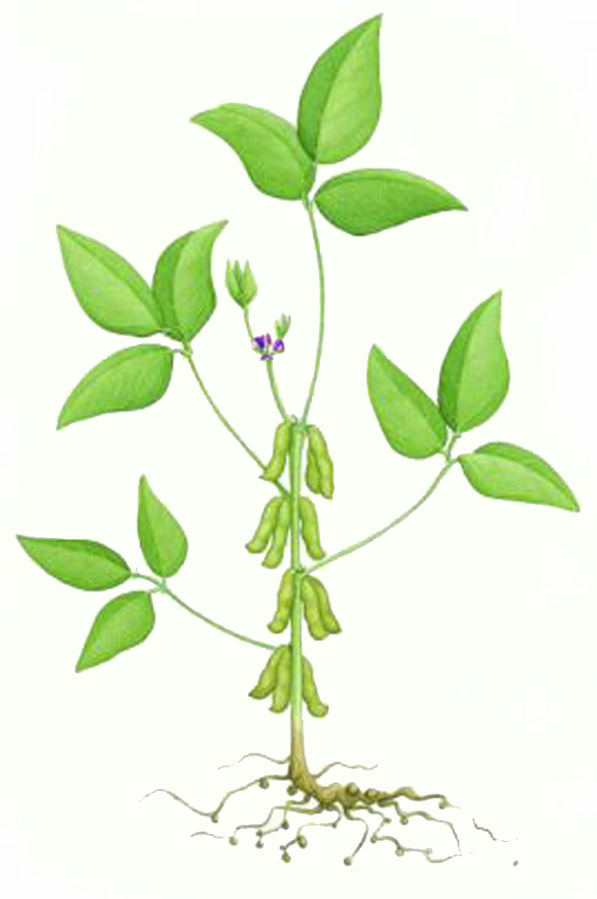
Can you guess different parts of this plant?
Notes:
Students to guess names of different plants- students can say in their own language.
Students should be knowing- roots, leaf, flower etc. this slide is only for bringing students prior knowledge to the classroom.

Slide 10
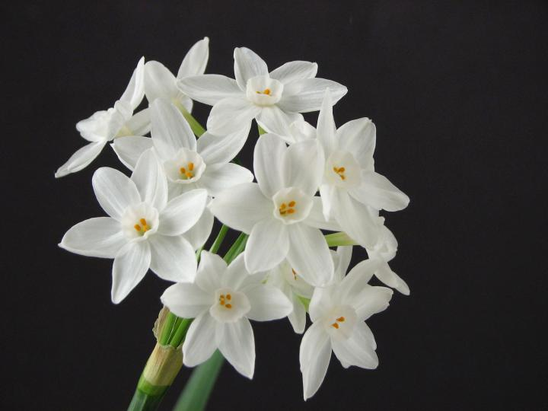
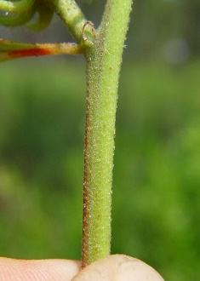
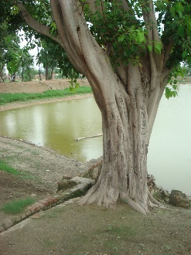
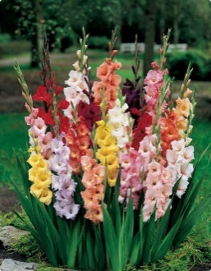
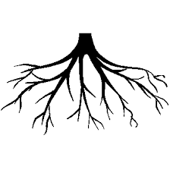
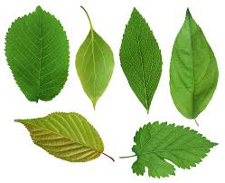
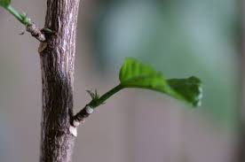
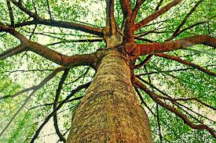
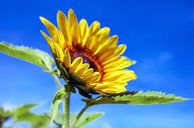
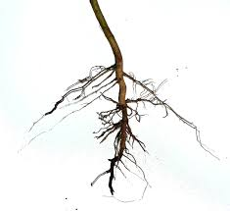
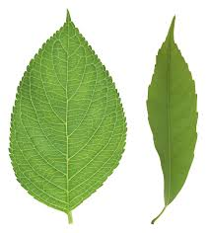
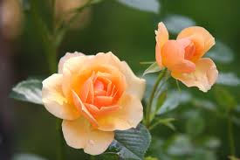
Can you help to organize them/bring similar ones together.
Notes:
Students will have to organize different parts seen in this slide. Group them based on the parts

Slide 11
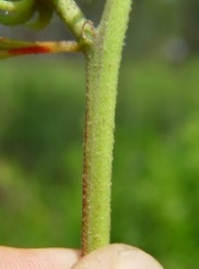
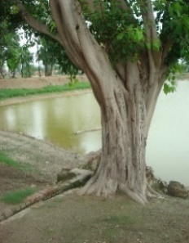
Flowers
Leaves
Roots
Stem
Notes:
To name each of the groups- flowers, leaves, stem, root

Slide 12
Project idea: Collect different leaves and flowers to make an album.
Please refer: Thisaimaani, June 2017
Page: 40, ‘The plant fairy’
Notes:
This project is described in Thisaimaani. Please read the project idea and try it in the classroom.

Slide 13
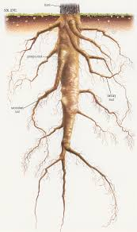
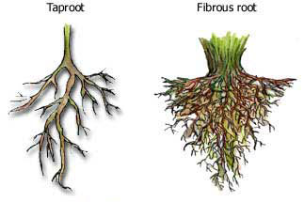
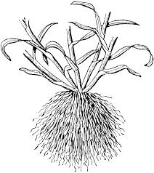
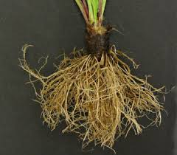
Roots:
Notes:
Discuss on types of root they have collected- what is the role roots have? Students could guess- they need now know about taproot and fibrous root.
But could talk about root as a support, root as a channel to take in water.

Slide 14
Stem:

Slide 15
Leaf:
Notes:
Students can be asked to categorize leaves they have collected based on its- color, shape, size and margins. This can be pasted on a paper to create leaf album.

Slide 16
Flowers:
Notes:
A discussion could be done on the variety of flowers around us.

Slide 17
What have we learned so far?
What did you like about the activity?
What you did not like about the activity?
Notes:
Students can be asked to share their thoughts for each of this questions. Their responses can be captured on the black board

Slide 18
Some points to remember:
There are living and non living things around us
Plants are living beings
Plants are diverse and there are a lot of variety
A plant has different parts- roots, stem, leaf, flower
Each part is different plant to plant
Notes:
Teachers could add more points- these are only pointers.

